Slide 1
MASKING DECISION
SEP or MTObjects?
Evidence from four-fold toy-object optimisation and 182-galaxy production runs
Recommendation: combine both methods with explicit scientific safety gates.
Decision briefing | 16 August 2026
Notes:
[Sources]
Project SEP and MTObjects optimisation outputs; comparison report dated 16 August 2026.

Slide 2
The evidence supports a gated two-algorithm workflow
02
USE TOGETHER
Operating rule
SEP finds more toys.
Accept components found by both methods
Screen SEP-only components by size, shape and position
Quarantine masks above 15% or with profile damage
Fall back to MTObjects or a conservative SEP rerun
MTObjects is less likely to over-mask galaxy structure.
One unattended method: MTObjects
MSc Research | Toy-object foreground masking | 16 August 2026
Notes:
[Sources]
Project comparison report, sections 4â€“5.

Slide 3
The comparison separates recovery from production risk
03
FOLD 1
FOLD 2
FOLD 3
FOLD 4
30 train
30 train
30 train
30 train
10 held out
10 held out
10 held out
10 held out
40 common-set check
40 common-set check
40 common-set check
40 common-set check
Then: selected model to all 182 galaxies, producing aligned eight-panel PNG reports
Caveat: the SEP and MTObjects runs used different toy-injection seeds and different scalar objectives. Compare shared recovery and masking metrics, not raw objective scores.
MSc Research | Toy-object foreground masking | 16 August 2026
Notes:
[Sources]
SEP CV run 20260816_185737; MTObjects recovery run 20260816_063455.

Slide 4
SEP recovered more injected contaminants across held-out folds
04
Four-fold held-out mean
Toy recall | SEP
57.3%
+9.7 pp
Toy recall | MTO
47.6%
SEP toy-recall advantage
Toy detection | SEP
57.9%
+7.5 pp
Toy detection | MTO
50.4%
SEP toy-detection advantage
Masked area | SEP
6.6%
Masked area | MTO
7.5%
MSc Research | Toy-object foreground masking | 16 August 2026
Notes:
[Sources]
Held-out means calculated from four-fold SEP and MTObjects result summaries.

Slide 5
Production behaviour reverses the safety ranking
05
Masked image area across 182 galaxies
Mean | SEP
11.7%
30
Mean | MTO
8.9%
SEP galaxies above 15%
95th percentile | SEP
20.0%
95th percentile | MTO
12.7%
1
MTObjects galaxy above 15%
Maximum | SEP
42.0%
Maximum | MTO
19.0%
MSc Research | Toy-object foreground masking | 16 August 2026
Notes:
[Sources]
SEP and MTObjects 182-galaxy apply-summary CSV files.

Slide 6
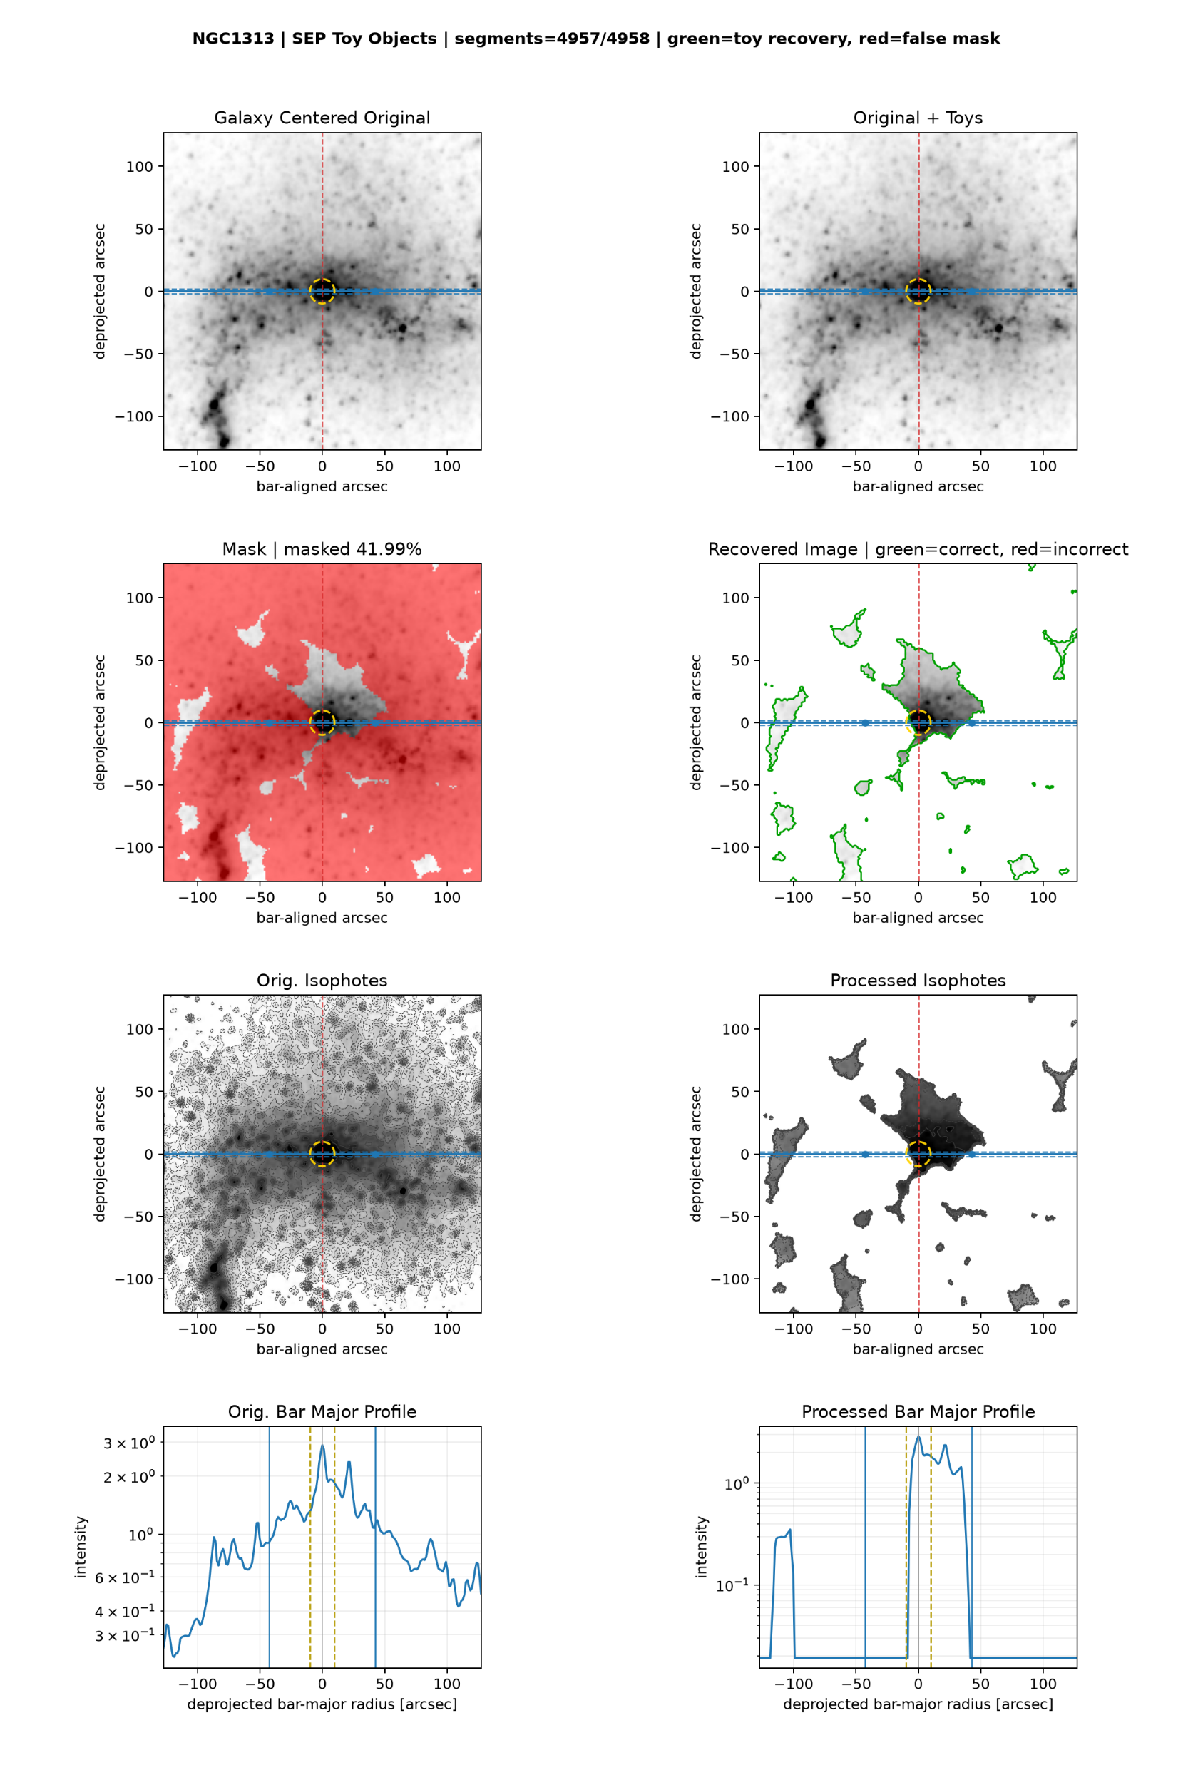
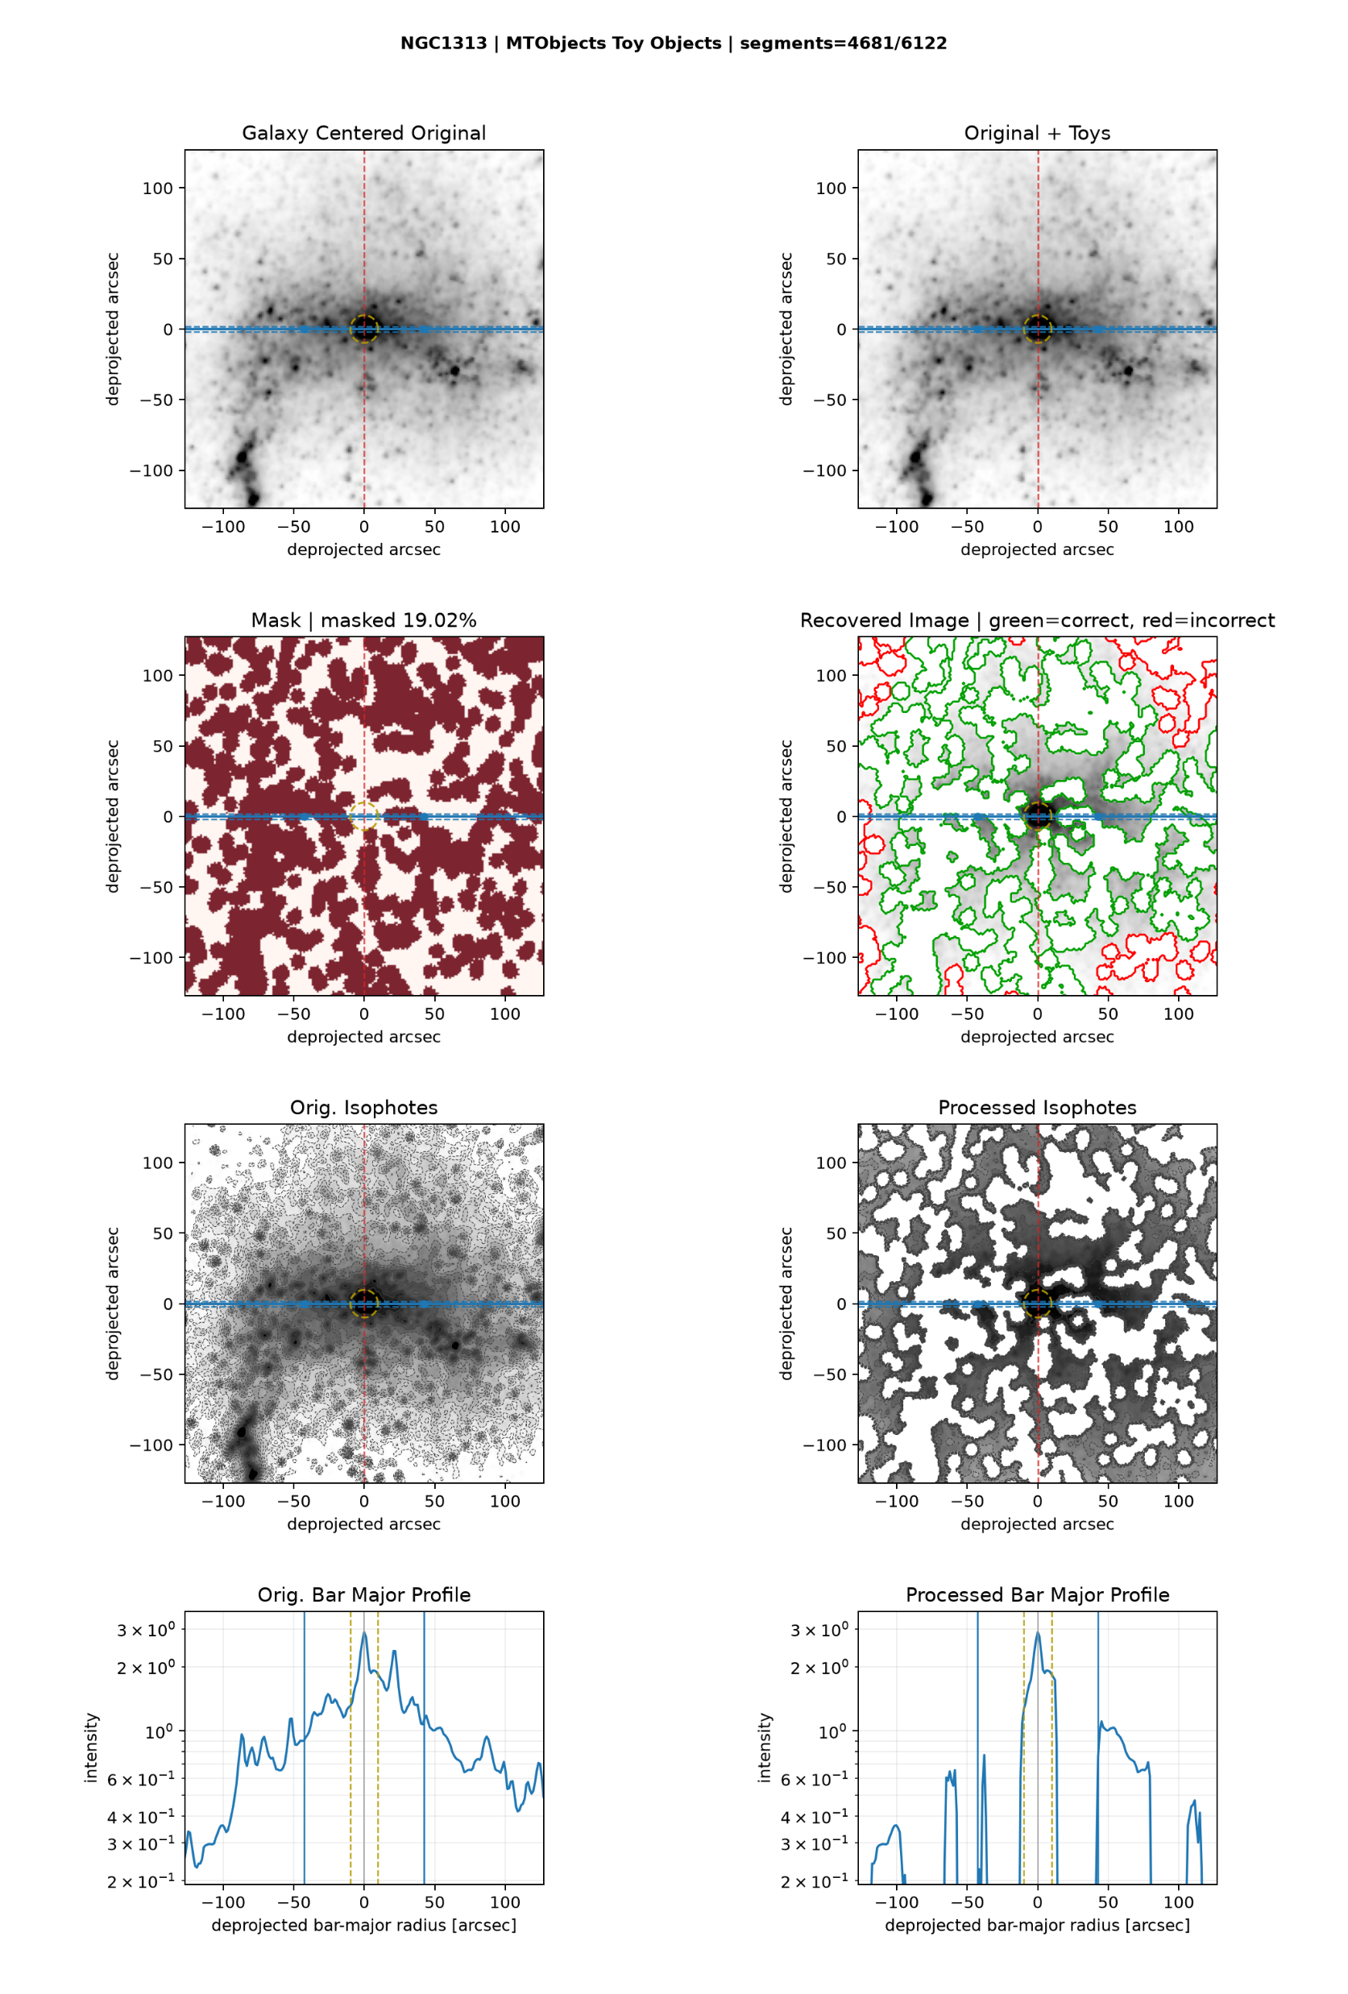
NGC1313 illustrates why recovery needs a safety gate
06
SEP | 42.0% masked
MTObjects | 19.0% masked
Use the mask, recovered-image outlines, isophotes and bar-major profiles together, not masked fraction alone.
MSc Research | Toy-object foreground masking | 16 August 2026
Notes:
[Sources]
User-generated PNG reports: D:\Dropbox\Public Documents\UCLAN\MSc Research\Remove foreground objects\SEP all galaxy batch\sep_toy_cv_20260816_185737\NGC1313_sep_thr1.9_area14_deb0.0030_dil6.png ; D:\Dropbox\Public Documents\UCLAN\MSc Research\Remove foreground objects\mtobjects all galaxy batch\mtobjects_toy_recovery_20260816_063455_eight_panel_aligned\NGC1313_mtobjects_optimised_report.png

Slide 7
Choose the operating mode before choosing the algorithm
07
UNATTENDED SCIENTIFIC BATCH
RECOVERY-FIRST + HUMAN REVIEW
Use MTObjects
Use gated SEP
Lower mean and tail masking
Only one result above the 15% review gate
Safer default for preserving galaxy structure
Higher toy recall and detection
Review every mask above 15%
Reject obvious isophote or bar-profile damage
Best overall: retain both component maps and accept agreement automatically.
MSc Research | Toy-object foreground masking | 16 August 2026
Notes:
[Sources]
Project comparison report, decision and operating recommendation.

Slide 8
Optimise recovery and scientific safety as separate goals
08
Hard constraints
Tail-risk loss
Reject >15% masks, low detection, or profile-damage failures.
Penalise the worst 10% of galaxies, not only the mean.
Component metrics
Profile preservation
Reward per-toy recovery; penalise false components and area separately.
Add isophote, centre-gradient and bar-major-profile distortion.
Repeated seeds
Pareto selection
Optimise median recovery plus lower-tail performance over several injections.
Keep recovery, false masking and profile damage as visible objectives.
MSc Research | Toy-object foreground masking | 16 August 2026
Notes:
[Sources]
Recommendations derived from observed cross-validation and production-tail behaviour.

Slide 9
Build a robust masking pipeline in six steps
09
1
Review the 30 SEP reports above 15%
2
Save labelled components from both algorithms
3
Implement agreement and SEP-only screening rules
4
Add masked-area and profile-damage release gates
5
Re-optimise with repeated seeds and tail-risk loss
6
Benchmark Photutils as an independent third method
Decision
Approve gated ensemble development; use MTObjects until the gates are validated.
MSc Research | Toy-object foreground masking | 16 August 2026
Notes:
[Sources]
Photutils SourceFinder: https://photutils.readthedocs.io/en/stable/api/photutils.segmentation.SourceFinder.html

